Slide 1
Incompressible Inviscid Flow
By
Dr. S. S. Baral

Slide 2
Outline
Momentum equation for frictionless flow
Euler’s equation in streamline coordinates
Bernoulli’s equation
Bernoulli’s equation (as energy equation)
Energy grade line and hydraulic grade line

Slide 3
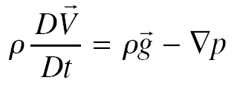

Momentum equation for frictionless flow : Euler’s equation
Euler’s equation – invsicid flow (viscosity= 0)
It is also applicable to rigid body motion
viscous stresses are not present as there is no deformation
viscosity is not zero
For incompressible flow, continuity equation (conservation of mass)

Slide 4
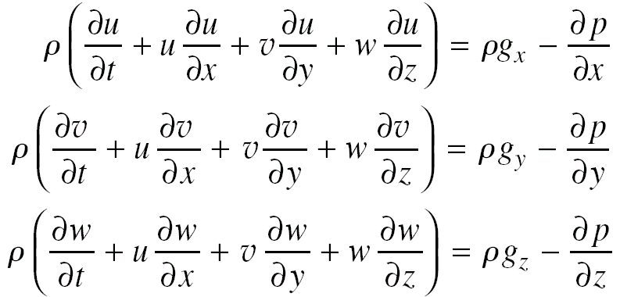
Euler’s equation
In rectangular coordinates
In cylindrical coordinates
Eqs 6.3a, b, c

Slide 5
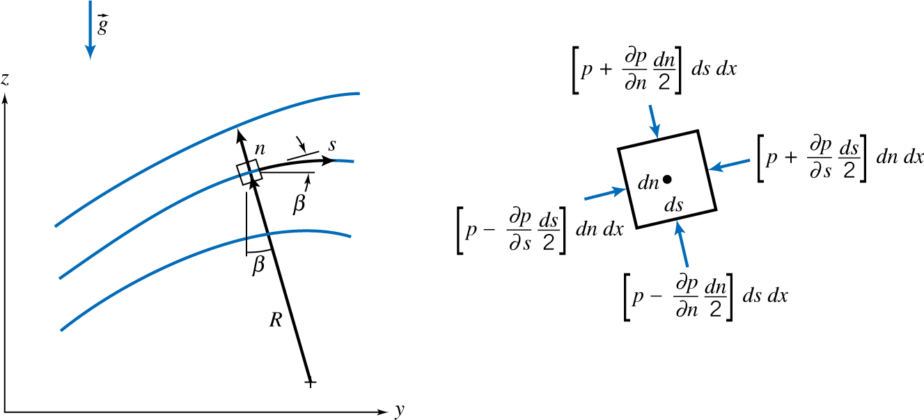
Euler’s equation in streamline coordinates
Steady flow (Streamlines and pathlines coincide)
Streamline coordinates
s – distance along a streamline
n – distance normal to the streamline
Pressure at the center of fluid particle → p

Slide 6
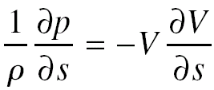
Euler’s equation in streamline coordinates
Applying Newton’s second law in the direction ‘s’ of the streamline and simplifying (neglecting viscous and body forces)
Decrease in velocity is accompanied by increase in pressure and vice versa.
Only force exerted is pressure force (particle accelerates toward low pressure region and decelerates toward high pressure region)

Slide 7
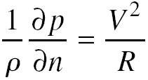
Euler’s equation in streamline coordinates
Applying Newton’s second law in a direction ‘n’ normal to the streamline (neglecting viscous forces and body forces)
Pressure increases in the direction outward from the center of curvature of the streamlines
Only force exerted is pressure force (and this pressure field creates centripetal acceleration)

Slide 8
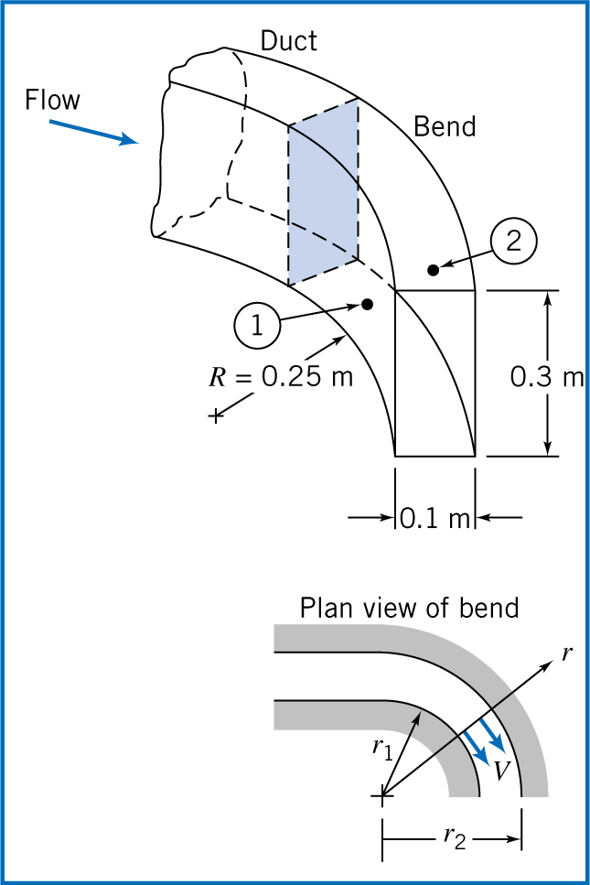
Example - Flow in a bend
Air flows at standard condi-
-tions in a flat duct bend
Δp = 40 mm of water
Determine volume flow
rate (Q)

Slide 9
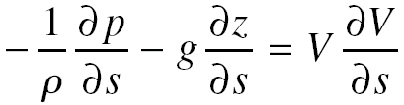
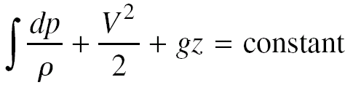
Bernoulli’s equation
Integration of Euler’s equation along a streamline for steady flow
Euler’s equation for steady flow, along a streamline
Simplifying above equation for movement of a particle by distance ‘ds’ (and integrating)

Slide 10
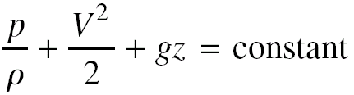
Bernoulli’s equation
Incompressible flow (density = constant)
Assumptions/restrictions
Steady flow
Incompressible fluid flow
Frictionless (Inviscid) flow
Flow along a streamline

Slide 11
Bernoulli’s equation
Based on work energy principle
Work done on a particle by all forces acting on the particle is equal to the change of kinetic energy of the particle
Bernoulli’s equation
In terms of energy
In terms of heads
In terms of pressures

Slide 12
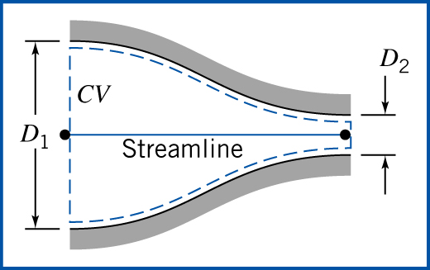
Example – Nozzle flow
Water flows steadily through a horizontal nozzle discharging to the atmosphere
D₁= 75 mm, D₂ = 25 mm
Determine
Inlet pressure (p₁) as a
function of Q (volume flow rate)
P_{1g} when Q = 0.02 m³/s
Notes:
Gauge pressure required to get 0.02 m³/s = 819775 Pa.

Slide 13
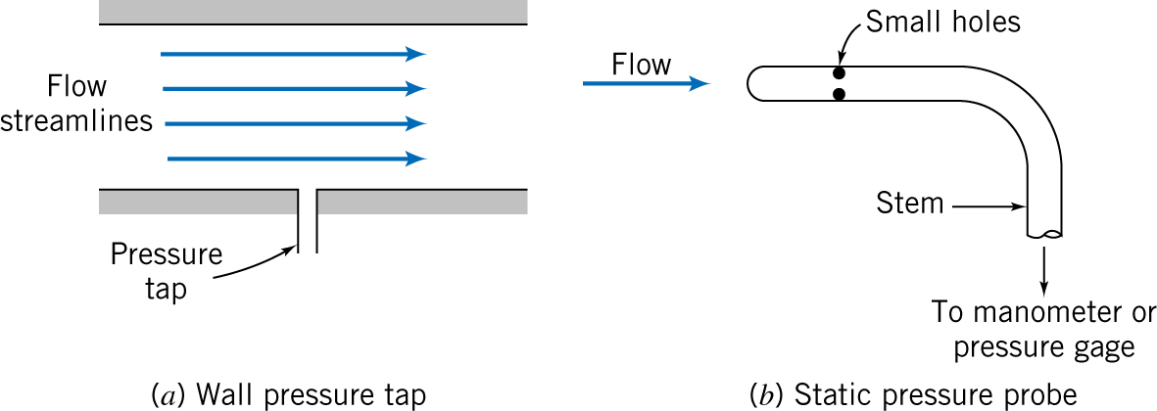
Static, stagnation and dynamic pressures
Static pressure
Thermodynamic pressure
Pressure experienced by a fluid particle as it moves
Measured by using wall pressure tap or static pressure probe

Slide 14
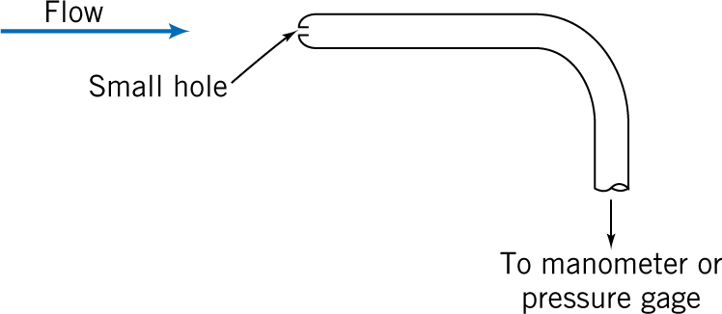
Static, stagnation and dynamic pressures
Stagnation pressure
Pressure obtained when a flowing fluid is decelerated to zero by a frictionless process
Measured with stagnation pressure probe or pitot tube

Slide 15
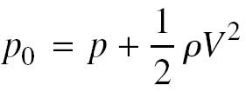
Static, stagnation and dynamic pressures
Bernoulli’s equation (neglecting elevation differences)
Relates changes in pressure and speed
Stagnation pressure for the above mentioned case is
Flow speed can be computed by measuring static and stagnation pressures
Stagnation
Dynamic
Static

Slide 16
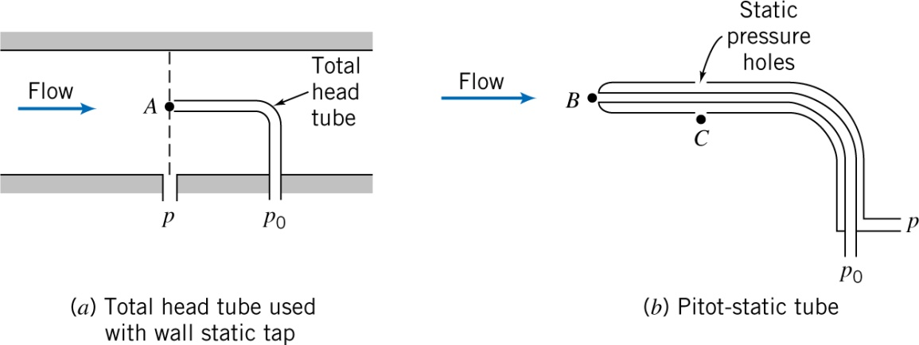
Static, stagnation and dynamic pressures
Measurement of static and stagnation pressure at the same point
Total head tube used with wall static tap
Pitot – static tube
All the above computations are applicable only for incompressible flow

Slide 17
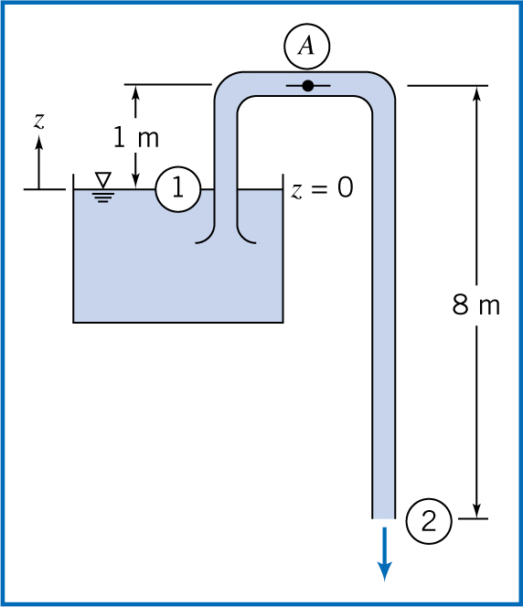
Example – Flow through a siphon
U – tube acts as a water siphon, Water outlet is a jet at atm pressure (as shown in fig)
Determine speed of free jet and minimum absolute pressure of water

Slide 18
Bernoulli’s equation
Application
Can be applied between any two points on a streamline provided all restrictions apply
Cautions on using this equation
Need to be careful while dealing with following cases
Subsonic diffusers – boundary layer grows
Siphon/tubes having inlets with sharp corners, abrupt bends
Long tubes
Cannot be used for
Flow through a hydraulic jump
Flow through a machine (pump, compressor, turbine, etc.)
Flow of gases (M < 0.3) through a heating element

Slide 19
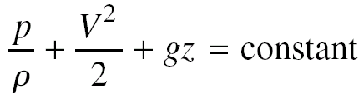
Bernoulli equation – as energy equation
Energy equation
Assumptions
No Shaft Work
No Shear Force Work
No Other Work
Steady Flow
Uniform Flow and Properties
Incompressible Flow
u₂ – u₁ – δQ/δm = 0

Slide 20
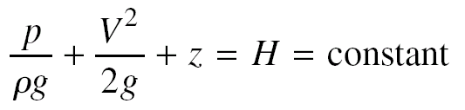
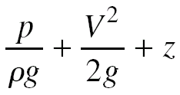


Energy grade line/ Hydraulic grade line
Energy equation
Energy grade line (EGH)
Hydraulic grade line (HGH)

Slide 21
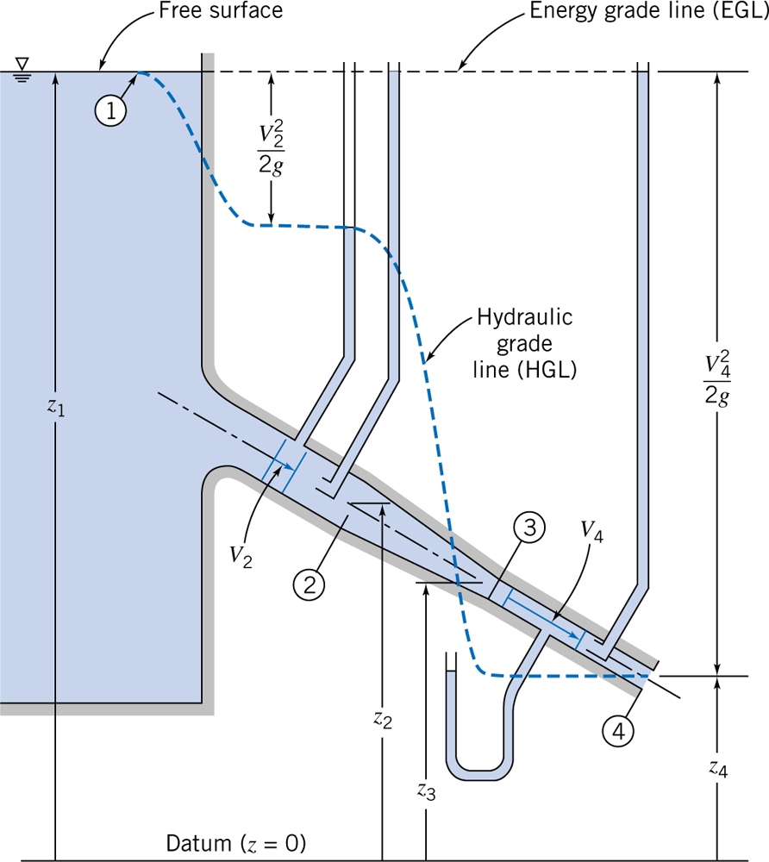
EGL and HGL for frictionless flow
EGL is constant for incompressible, inviscid flow (in absence of work devices and friction)
HGL is always lower than EGL
Velocity depends on overall system and change in velocity occur only when diameter changes

Slide 22
Problem-1
Consider the flow field with velocity given by V = [A(y²-x²)-Bx]i+[2Axy+By]j; A= 3.28 m⁻¹.s⁻¹, B=3.28 m⁻¹.s⁻¹; the coordinates are measured in meter. The density is 1030 kg/m³, and gravity acts in the negative y direction. Calculate the acceleration of a fluid particle and the pressure gradient at point (x, y) — (1, 1).

Slide 23
Problem-2
A horizontal flow of water is described by the velocity field V = (Ax + Bt)i +{-Ay + Bt)j, where A = 5 s⁻¹, B = 3 m• s⁻², x and y are in meter, and t is in sec. Find expressions for the local acceleration, the convective acceleration, and the total acceleration. Evaluate these at point (0.6, 0.6) at t = 5 seconds. Evaluate ▽p at the same point and time.

Slide 24
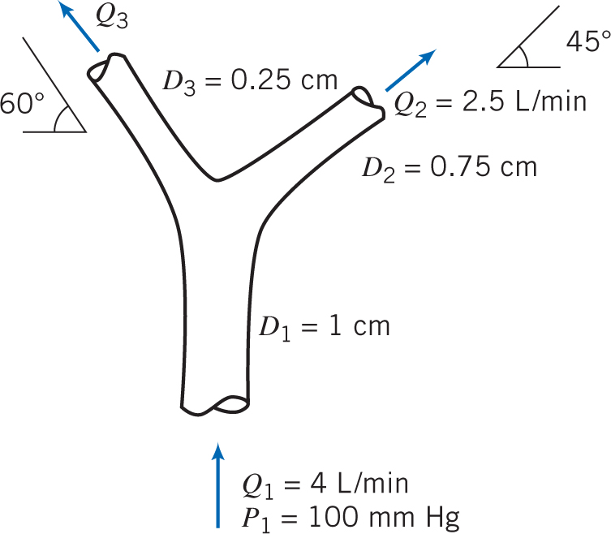
Problem-3
The branching of blood vessel is shown. Blood at pressure of 100 mm Hg flows in the mail vessel at 4 L/min. Estimate the blood pressure in each branch. Assuming that blood vessel behave as a rigid tubes, that we have friction less flow, and that the vessel lies in the horizontal plane. What is the force generated at the branch by the blood? Assume the density of blood as same as water.

Slide 25
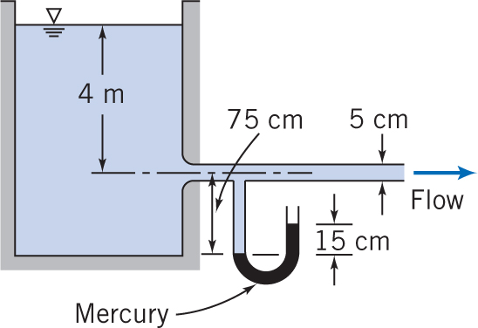
Quiz-4
Water flows from a very large tank through a 5 cm. diameter tube. The dark liquid in the manometer is mercury. Estimate the velocity in the pipe and the rate of discharge from the tank.

